Slide 1
End-to-End Deep Learning Speech Recognition Platform
Stanislav Barabanov, Vladimir Kleiner
Supervisors: Omri Allouche, Shua Dissen, Aliaksei Kolesau

Slide 2
Introduction & Overview

Slide 3
The Company
Gong is an acknowledged leader in the revenue intelligence space. Its technology “understands” business conversations and provides advice.
Gong has access to huge amounts of data including recorded voice conversations, written documents and CRM (Customer Relationship Management) data

Slide 4
Business Problem
Demand for Automatic Speech Recognition (ASR) for more languages
Classical Approach to ASR takes years to develop
End-to-End Deep Learning Approach greatly simplifies the pipeline for building ASR systems

Slide 5

Performance Metrics
Word Error Rate (WER):
Count of substitutions, deletions, and insertions required to produce the referenced sentence from the predicted sentence divided by the length of the reference
$$WER=\frac{N_{sub}+N_{del}+N_{ins}}{N_{ref}}$$
Inference Time Factor:
The factor between the time-of-inference and the time-duration of the utterance

Slide 6
Project Goals
Basic Goal
Develop an E2E Deep Learning based system for ASR in Spanish
Inference Time Factor is x5
Advanced Goal
Beat "Amazon Comprehend" on Gong's datasets
WER for Spanish : 40+%

Slide 7
Details and Methods

Slide 8
Basic Stages
Select the Framework
Select a high-quality robust architecture for ASR
Select high quality datasets and a learning strategy
Produce the Learned Model
Optimize the model for speed and price of inference

Slide 9
Open Source Frameworks
NVIDIA: NeMo
NVIDIA: OpenSeq2Seq
Mozilla: DeepSpeech
Facebook: Wave2Letter
Johns Hopkins University: ESPnet
and more…
* ESPnet is based on Kaldi ASR, a famous framework for speech recognition initially developed in far 2009.

Slide 10
Modelling pipeline
Data preparation and validation
Encoding input sentences into subwords
Language Model training
Decoding and Scoring
Acoustic Model training

Slide 11
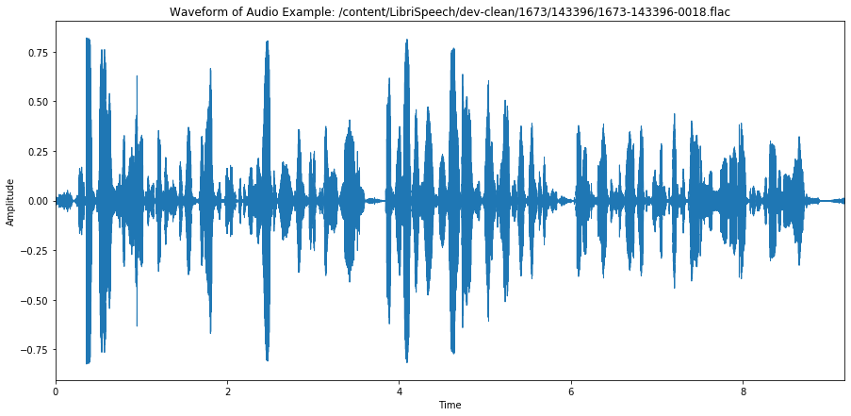
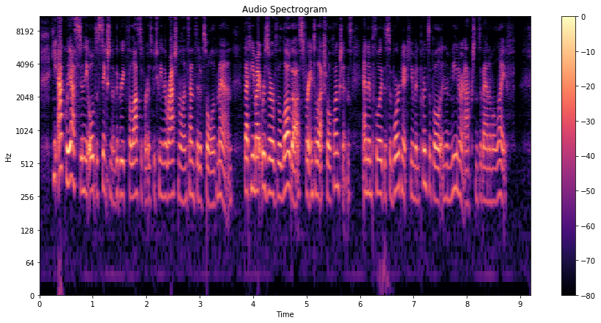
Data preparation and feature extraction
Text preprocessing 1. Lowering text 2. Removing special characters 3. Encoding digits/numbers into words
Audio preprocessing (features) 1. Signal normalization 2. Framing – typically 25 ms frames with 10ms shift 3. log-compressed filterbank, “log-mel-filterbank” (motivated by the auditory system )

Slide 12
Three Components of the ASR Model
Subword Tokenization Dictionary
Language Model
Acoustic Model

Slide 13
Subword Tokenization
Generate subword tokens according to the frequency of their appearance in the text
The motivation: Frequently present tokens will have better chances to be learned by both AM and LM
We used “Byte Pair Encoding” and “Unigram” algorithms

Slide 14
Language Model
Used in the Decoding Stage to improve the results of the AM
We used Transformer-based LM

Slide 15
Acoustic Model
RNN (LSTM, GRU) with Attention + CTC*
RNN Transducer with Attention
Transformer + CTC
Wave2Letter
Jasper
QuartzNet
* CTC – Connectionis Temporal Classification, an approach used when the duration of a symbol is variable

Slide 16

Transformer
As it defined in
“Attention is all you need”

Slide 17

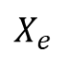
Transformer + CTC + LM for ASR
Joint Decoder
$\hat{Y}={argmax}_{Y∈Y^{∗}}\{α×log(p_{ctc}(Y|X_{e}))+(1−α)×log(p_{att}(Y|X_{e}))+γ×log(p_{lm}(Y))\}$
CTC
Decoder
Attention Decoder
LM
$$X_{e}$$
Input: subsampled sequence of log-mel-fileterbunk frames
Output: sequence of subword-tokens obtained using beam search, which combines the scores of CTC-Decoder, Attention-Decoder and LM
$Y^{∗}$ is a set of hypotheses
$α$ and $γ$ are hyperparameters
Subsampling
(2 x Conv2d or VGG)
Input Sequence of
log-mel filterbank frames

Slide 18
Data, Experiments, Results

Slide 19
What is our data?
Public Spanish datasets 1) TEDx Spanish 2) Mozilla Common Voice 3) Crowdsource by Google 4) Kaggle Spanish – dropped, as had no speaker labeling information
Gong datasets 1) Supervised data (annotated by humans) 2) Unsupervised data (annotated automatically by “Amazon Comprehend”)

Slide 20
Models trained on Public Datasets
Dataset | Utterances | Hours | Speakers | Epochs of training | WER test set – own | WER test set – Gong supervised
Common Voice | 148,375 | 165 | 7147 | 100 | 20.6 | 66.3
TEDx | 11,243 | 24 | 147 | 160 | 41.8 | 65.5
Crowdsource | 15,739 | 25 | 21 | 120 | 22.5 | 97.4
No Augmentation
ctc-weight: 0.99,
lm-weight: 0.01,
beam-size: 6

Slide 21
Models trained on Gong Datasets
Dataset | Utterances | Hours | Speakers | Epochs of training | WER test set – own unseen | WER test set – Gong supervised
Gong Unsupervised | 84,804 | 280 | 3026 | 100 | 43.9 | 41.4
Gong Unsupervised + Supervised without shuffling | 84,804 + 3,435 | 280 + 3.5 | 3026 + 62 | 100 | 31.8 | 33.2 (unseen part of supervised data)
No Augmentation
ctc-weight: 0.99,
lm-weight: 0.01,
beam-size: 6

Slide 22
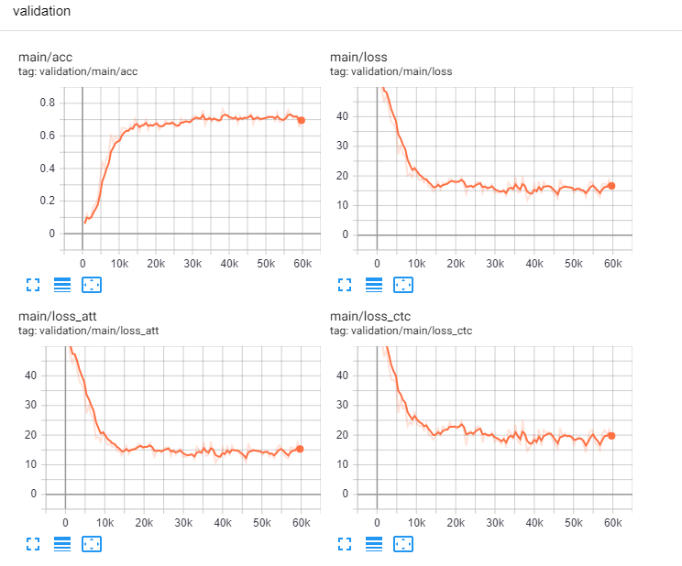
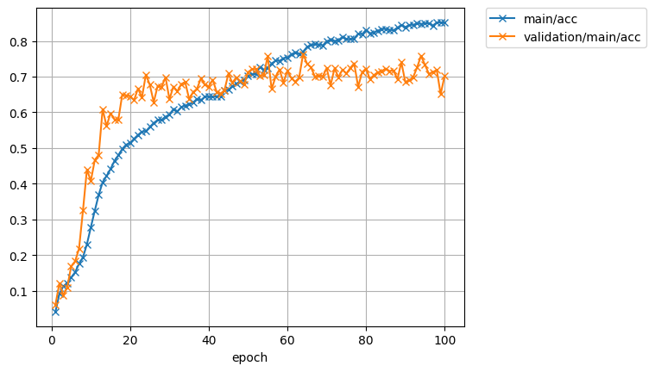
Training process for the Gong dataset
As we see, model rapidly goes to saturated condition (validation accuracy stops increasing). In this experiment, unsupervised data was used for training and supervised data was used for validation

Slide 23
Hyperparameter tuning
Data set | hours | WER (own) ctc-weight: 0.99, lm-weight: 0.01, beam-size: 6 | WER (own) ctc-weight: 0.3, lm-weight: 0.01, beam-size: 6 | WER (own) ctc-weight: 0.3, lm-weight: 0.6, beam-size: 6 | WER (Gong) ctc-weight: 0.99, lm-weight: 0.01, beam-size: 6
Common Voice | 165 | 20.6 | 13 | 11.4 | 66.3
TEDx | 24 | 41.8 | 41.1 | 44.6 | 65.5
Crowdsource | 25 | 22.5 | 9.4 | 8.7 | 97.4
Gong unsupervised | 280 | 43.9 | 42.9 | Lack of time =( | 41.4
Gong unsupervised + Supervised | 280 + 3 | 31.8 | Had no time =( | Lack of time =( | 33.2
No Augmentation

Slide 24
Inference Time Factor
Inference time ~ 3 min per utterance of 5 sec on a single CPU-core*
Factor ~ x36 **
per CPU-core
more CPU-cores reduce the Factor by the number of cores
* Instance: p3.2xlarge, inference was done on CPU (not GPU) ** Project goal is x5

Slide 25
Conclusions
For Gong Dataset, we achieved ~33% WER which is better than “Amazon Comprehend” ASR for Spanish
Adding, without shuffling, small amount of human-validated data (3 hours) to the “unsupervised” noisy training set (~300 hours) lead to the >8% improvement in WER
None of the training sessions showed signs of overfitting after 100+ epochs
With “Transformer + CTC”, Inference Time Factor is large, but can be scaled horizontally with more CPU cores.

Slide 26
Future Work
More Supervised Data from Gong
Hyperparameters tuning
Data Augmentation
Transfer Learning
Inference Speed Improvement based on “Streaming Automatic Speech Recognition with the Transformer Model” N. Moritz et al., June 2020

Slide 27
Questions?

Slide 28
Supporting Slides

Slide 29
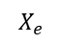
Future Work: Transfer Learning for Transformer Acoustic Model
Unfreeze selected or all layers of pretrained model
Set reduced learning rate (can be done for each layer separately)
CTC
Decoder
Attention Decoder
$$X_{e}$$
Subsampling
Input Sequence of
log-mel filterbank

Slide 30
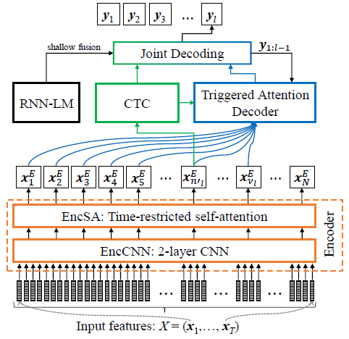
Future Work: Streaming ASR with Transformer Acoustic Model
“Streaming Automatic Speech Recognition with the Transformer Model” N. Moritz et al., June 2020
Based on:
Time-Restricted Self Attention for the Encoder
Triggered Attention for the encoder-decoder attention mechanism
Overall processing delay of few seconds per utterance is reported in the paper

Slide 31
Acoustic Model – Transformer architecture
(decoder): Decoder(
(embed): Sequential(
(0): Embedding(5002, 512)
(1): PositionalEncoding(
(dropout): Dropout(p=0.1)
)
)
(decoders): MultiSequential(
(0): DecoderLayer(
(self_attn): MultiHeadedAttention(
(linear_q): Linear(in_features=512, out_features=512, bias=True)
(linear_k): Linear(in_features=512, out_features=512, bias=True)
(linear_v): Linear(in_features=512, out_features=512, bias=True)
(linear_out): Linear(in_features=512, out_features=512, bias=True)
(dropout): Dropout(p=0.0)
)
(src_attn): MultiHeadedAttention(
(linear_q): Linear(in_features=512, out_features=512, bias=True)
(linear_k): Linear(in_features=512, out_features=512, bias=True)
(linear_v): Linear(in_features=512, out_features=512, bias=True)
(linear_out): Linear(in_features=512, out_features=512, bias=True)
(dropout): Dropout(p=0.0)
)
(feed_forward): PositionwiseFeedForward(
(w_1): Linear(in_features=512, out_features=2048, bias=True)
(w_2): Linear(in_features=2048, out_features=512, bias=True)
(dropout): Dropout(p=0.1)
)
(norm1): LayerNorm(torch.Size([512]), eps=1e-12, elementwise_affine=True)
(norm2): LayerNorm(torch.Size([512]), eps=1e-12, elementwise_affine=True)
(norm3): LayerNorm(torch.Size([512]), eps=1e-12, elementwise_affine=True)
(dropout): Dropout(p=0.1)
)
(1): DecoderLayer(...)
(2): DecoderLayer(...)
(3): DecoderLayer(...)
(4): DecoderLayer(...)
(5): DecoderLayer(...)
)
(after_norm): LayerNorm(torch.Size([512]), eps=1e-12, elementwise_affine=True)
(output_layer): Linear(in_features=512, out_features=5002, bias=True)
)
(criterion): LabelSmoothingLoss(
(criterion): KLDivLoss()
)
(ctc): CTC(
(ctc_lo): Linear(in_features=512, out_features=5002, bias=True)
(ctc_loss): CTCLoss()
)
(encoder): Encoder(
(embed): Conv2dSubsampling(
(conv): Sequential(
(0): Conv2d(1, 512, kernel_size=(3, 3), stride=(2, 2))
(1): ReLU()
(2): Conv2d(512, 512, kernel_size=(3, 3), stride=(2, 2))
(3): ReLU()
)
(out): Sequential(
(0): Linear(in_features=10240, out_features=512, bias=True)
(1): PositionalEncoding(
(dropout): Dropout(p=0.1)
)
)
)
(encoders): MultiSequential(
(0): EncoderLayer(
(self_attn): MultiHeadedAttention(
(linear_q): Linear(in_features=512, out_features=512, bias=True)
(linear_k): Linear(in_features=512, out_features=512, bias=True)
(linear_v): Linear(in_features=512, out_features=512, bias=True)
(linear_out): Linear(in_features=512, out_features=512, bias=True)
(dropout): Dropout(p=0.0)
)
(feed_forward): PositionwiseFeedForward(
(w_1): Linear(in_features=512, out_features=2048, bias=True)
(w_2): Linear(in_features=2048, out_features=512, bias=True)
(dropout): Dropout(p=0.1)
)
(norm1): LayerNorm(torch.Size([512]), eps=1e-12, elementwise_affine=True)
(norm2): LayerNorm(torch.Size([512]), eps=1e-12, elementwise_affine=True)
(dropout): Dropout(p=0.1)
)
(2): EncoderLayer(...)
(3): EncoderLayer(...)
(4): EncoderLayer(...)
(5): EncoderLayer(...)
(6): EncoderLayer(...)
(7): EncoderLayer(...)
(8): EncoderLayer(...)
(9): EncoderLayer(...)
(10): EncoderLayer(...)
(11): EncoderLayer(...)
)
(after_norm): LayerNorm(torch.Size([512]), eps=1e-12, elementwise_affine=True)
)
78,356,756 parameters

Slide 32
Reading list
“Towards End-to-End Speech Recognition with Recurrent Neural Networks”, Graves et al., 2014
“SPEECH RECOGNITION WITH DEEP RECURRENT NEURAL NETWORKS”, Graves et al., 2014
“Attention-Based Models for Speech Recognition”, J Chorowski et al, 2015
“Attention Is All You Need”, A. Vaswani et al.
“The Annotated Transformer”, A. Rush, et al. (http://nlp.seas.harvard.edu/2018/04/03/attention.html)
“A COMPARATIVE STUDY ON TRANSFORMER VS RNN IN SPEECH APPLICATIONS”, S. Karita et al. (the authors are contributed the Transformer-based ASR into ESPnet)
“End-to-end speech recognition with word-based rnn language models”, T. Hori et al. 2018
“Improving Transformer-based End-to-End Speech Recognition with Connectionist Temporal Classification and Language Model Integration”, S. Karita et al.
“JOINT CTC-ATTENTION BASED END-TO-END SPEECH RECOGNITION USING MULTI-TASK LEARNING”, S. Kim et al.
“Joint CTC/attention decoding for end-to-end speech recognition”, T. Hori et al.
“Advances in Joint CTC-Attention based End-to-End Speech Recognition with a Deep CNN Encoder and RNN-LM” T. Hori et al.
“Effective Approaches to Attention-based Neural Machine Translation”, M Luong et al (2015)
“The Challenges of using Transformers in ASR”, D. Raj (https://desh2608.github.io/2020-01-08-transformer-asr/)
“Neural Machine Translation of Rare Words with Subword Unit”, R. Sennrich et al. (introduced BPE)
“TRANSFORMER-BASED ACOUSTIC MODELING FOR HYBRID SPEECH RECOGNITION”, Y Wang, et al. (“Though compared with the sequence-to-sequence or neural transducer architecture, the hybrid approach is admittedly less appealing as it is not end-to-end trained, it is still the best performing system for authors’ practical problems. It also has the advantage that it can be easily integrated with other knowledge sources (e.g., personalized lexicon) that may not be available during training. In this work, we aim to leverage the transformer to improve hybrid acoustic modeling”)
“Subword Regularization: Improving Neural Network Translation Models with Multiple Subword Candidates”, T.Kudo.
“SPEECH-TRANSFORMER: A NO-RECURRENCE SEQUENCE-TO-SEQUENCE MODEL FOR SPEECH RECOGNITION”, L. Dong et al.
“Tensor2Tensor for neural machine translation”, A. Vaswani et al.
“The Kaldi speech recognition toolkit”, D. Povey et al.
“Training Tips for the Transformer Model”, M. Popel et al.
“Connectionist temporal classification: Labelling unsegmented sequence data with recurrent neural networks”, A.Graves et al.
“A pitch extraction algorithm tuned for automatic speech recognition”, P. Ghahremani et al.
“STREAMING AUTOMATIC SPEECH RECOGNITION WITH THE TRANSFORMER MODEL”, N. Moritz et al.
“SentencePiece: A simple and language independent subword tokenizer and detokenizer for Neural Text Processing”, T. Kudo, J. Richardson
“Recurrent neural network based language mode”, T. Mikolov et al.
“Scaling Neural Machine Translation”, M. Ott et al.
“STREAMING AUTOMATIC SPEECH RECOGNITION WITH THE TRANSFORMER MODEL” N. Moritz
“Triggered attention for end-to-end speech recognition” N. Moritz
“Speech recognition for medical conversations” Chiu et al. (ASR with noisy transcripts)

